Slide 1
UBER APP
Students Names:
Mashal Dhyab Abdullah Al-Dhyab 443050042
Amer Yasser 443050853
Supervise Dr:
Mohammed Saad Mohammed Aserri

Slide 2
Feasibility Study:
1.1.0. Executive Summary
Ade Uber Drivers, Inc. is a licensed taxi e-hailing software app startup that plans to manage Uber drivers. We will be headquartered , and will also have operations in other major cities around the country. We opted to operate in these areas since our services will be in high demand due to the demographic makeup of the cities.
1.2.0. Our Products and Services
Ade Uber Drivers, Inc. is a typical Uber driver firm that is designed to create profit and competes favorably with the industry’s leading brands. Our service offerings are as follows:
Uber partners are hired, trained, and provided with drivers. Managing drivers and car fleets

Slide 3
3.0. Our Mission and Vision Statement
Our goal is to become the greatest Uber driver company in Saudia, with a strong presence in other major cities around the country.
4.0. Our Organizational Structure
We intend to establish an Uber driver services firm that would set the industry standard in Kingdom. We desire a motivated team that ensures our customers and partners are pleased and get good value for their money.
5.0. SWOT ANALYSIS
Strength:
Our strengths will be the key regions we aim to cover, the business model we intend to use, access to a pool of interested partners, a diverse fleet of highly dependable and comfortable vehicles, highly trained and courteous drivers, and our exceptional customer service culture.
b. Weakness:
Our main drawback is that we lack the financial ability and corporate structure to compete with Uber, necessitating our collaboration as an independent partner.
c. Opportunities:
Because we are starting in the heart of Ikeja-Lagos, we will have several possibilities to sell our services to a large number of professional drivers, business partners, corporate organizations, travel and tour agencies, hotels, government organizations, homes, and so on.

Slide 4
d. Threat
Our main danger will be the fact that we are not an independent firm, as well as the introduction of a new Uber services company in the area employing the same business model as us.
6.0. Our Target Audience
With the help of feasibility studies and market surveys, we find clients who would profit from our service as an Uber services company.
7.0. Our competitive advantage
We can confidently state that the strategic locations we intend to cover, the business model we intend to use, access to funds from partners and investors, ease of payment, a wide variety of dependable and luxurious cars, well-trained and polite drivers, and our prolific customer service culture will provide Ade Uber Drivers, Inc. with a competitive advantage.

Slide 5
Proposal Project
As Uber has grown in the past few years, you have made great inroads into disrupting the current taxi market for the transport of individual people. By bypassing taxi companies and empowering users with GPS data and peer reviews, you have created a seismic shift in the transportation market

Slide 6
Requirements:
UBER DRIVER CAR REQUIREMENTS:
There are a few Uber driver car requirements. You must:
Drive a 4-door car, truck, or minivan
Be 21 years of age or older
Have a valid driver’s license issued in the state where you will work for Uber
Have insurance
Pass a background check
Have at least three years of driving experience
Have a clean driving record
Have a vehicle fit to pass an Uber inspection

Slide 7
UBER CAR REQUIREMENTS:
UberX Cars must:
Seat at least four, not including the driver
Be a 4-door vehicle
Be a 2004 or newer

Slide 8
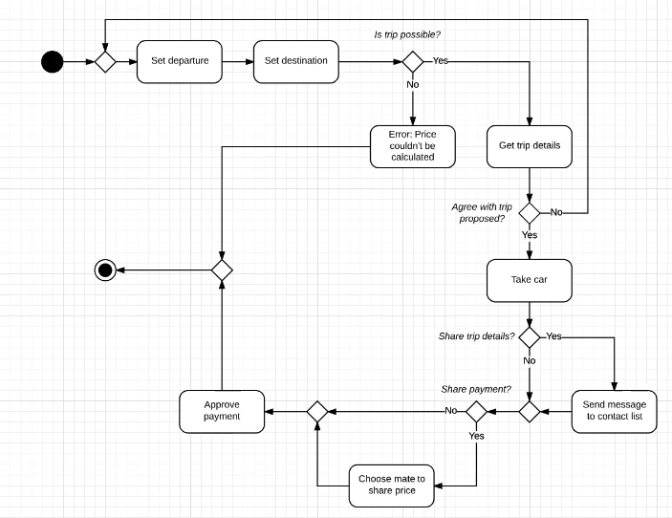
Activity Diagram

Slide 9
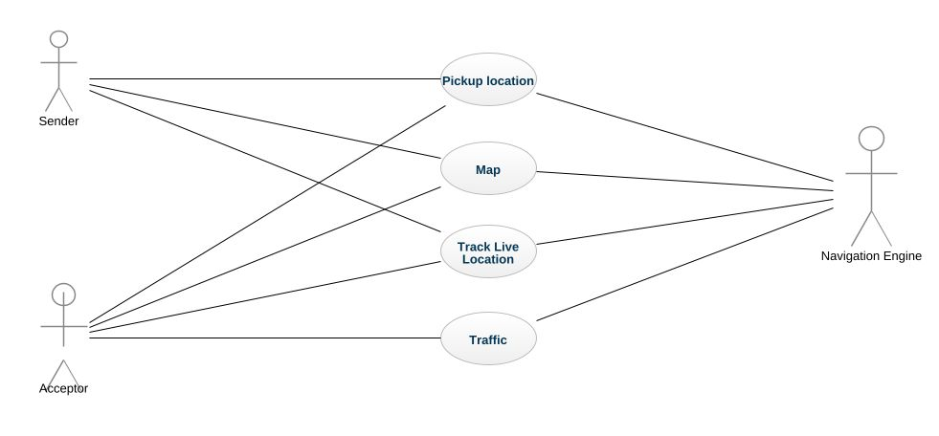
Use case modelling

Slide 10
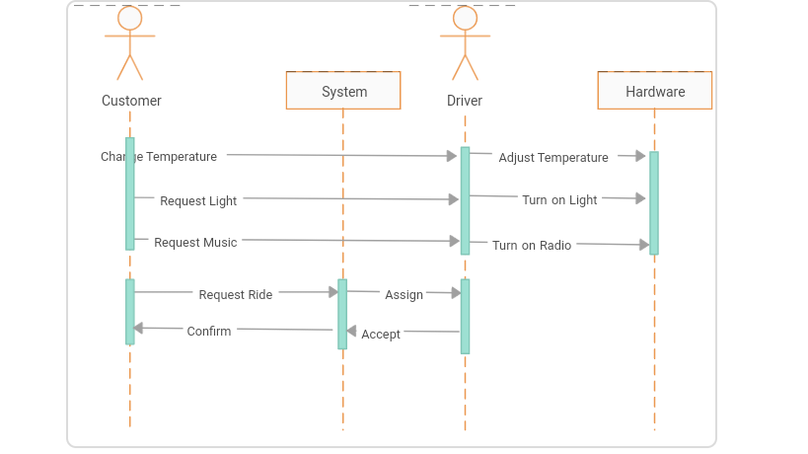
Sequence Diagram

Slide 11
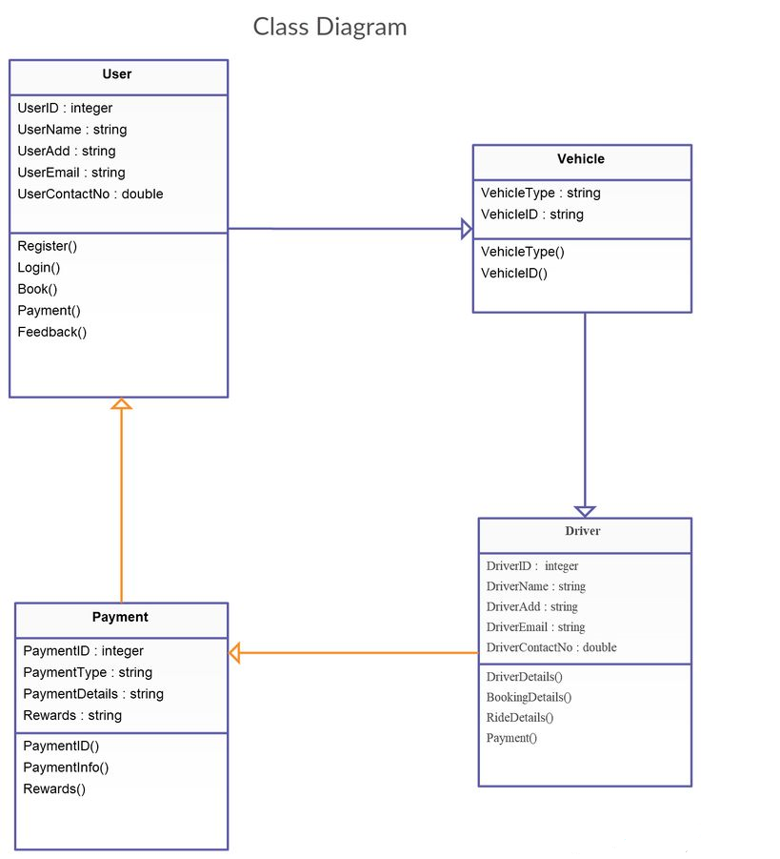
Class Diagram

Slide 12

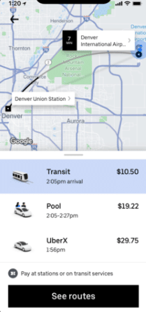
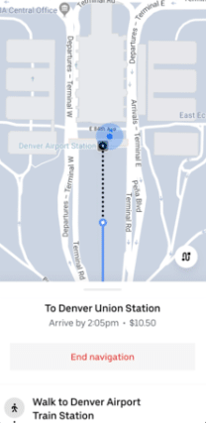
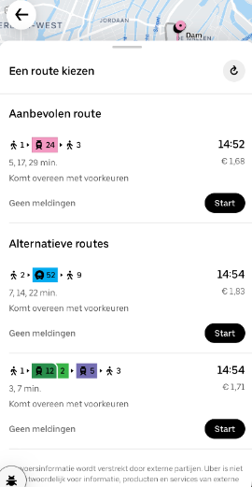
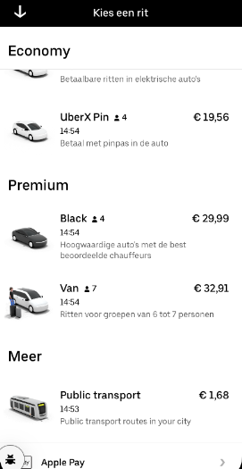
USER Interface

Slide 13
State of Uber App:
State | Description
app | use the app to request a ride
Driver | accepts your request
app | provides info about the driver with whom you will ride
Rider | enter your preferred destination anytime before or during the ride
Rating | after a trip ends, the app will ask you to rate your driver from 1 to 5 Stars

Slide 14
Stimuli of Uber App:
Stimulis | Description
Rider | A rider opens the app
Rider | The rider is matched with a driver
Driver | The driver picks up the rider
Driver | The driver takes the rider to the destination
Driver | The driver and rider leave ratings and reviews

Slide 15
Thanks!

